Slide 1
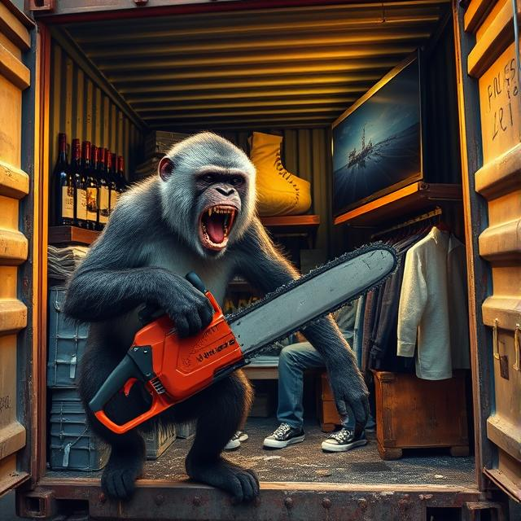
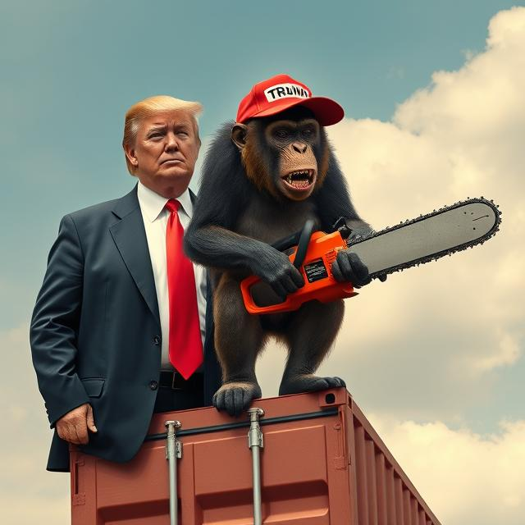
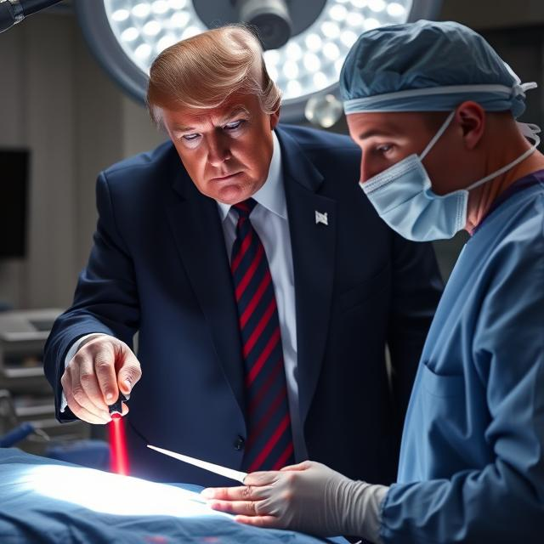

April 22, 2025
An Historical Perspective on Today’s Trade War
Craig VanGrasstek
Contents © 2025 Craig VanGrasstek
Notes:
Deep Dive: Public Procurement
Day Two Presentation

Slide 2
The Sequence of My Argument
The trade war now underway has its historical roots in:
The 17th Century for the underlying economic theory (Mercantilism), and the legal/diplomatic is based on
The 19th Century practice of unilateralism and a resort to bargaining-tariff tactics (which could ultimately lead to 1930s-style hostile trade blocs), but
The two contenders for hegemony have archetypes that give this trade war the potential to be very prolonged (with respect to China-U.S. if not other confrontations).
Notes:
Deep Dive: Public Procurement
Day Two Presentation

Slide 3
Point 1:
The Revival of Mercantilism
Notes:
Deep Dive: Public Procurement
Day Two Presentation

Slide 4
The Core Mercantilist Principles
Nationalism over Globalism: A state’s objectives are purely national, and any broader, global goals are to be pursued only to the extent that they serve national purposes.
Power and Wealth: There is an unbreakable bond between power (the primary objective) and wealth (the principal foundation of that power), both of which are finite, and states should seek to maximize their power by acquiring as much wealth as they can.
Interventionist Instruments: An active state should employ whatever trade measures or other instruments are best suited to securing national power and wealth, especially by favoring domestic production of essential goods and promoting exports of manufactures.
Adversarial and Asymmetric Relationships: A state must dominate or be dominated, and should adopt policies to attract and subordinate other states, undermine the adversary and its clients, and dissuade any remaining neutrals from choosing the wrong side.
Mercantilism is a recurring practice in history:
Version 1.0 appealed to European powers in the 16th to 18th centuries;
Version 2.0 appealed to rising states in the 18th and 19th centuries (see Alexander Hamilton’s America and Friedrich List’s Germany)
Version 2.1 appealed to developing countries in the 20th and into the 21st centuries (see Raul Prebisch and Ha-Joon Chang)
Version 3.0 has been gradually developing since the early 20th century, and appeals to the interests of declining hegemons or their challengers (most notably the United States versus China)
Notes:
Deep Dive: Public Procurement
Day Two Presentation

Slide 5

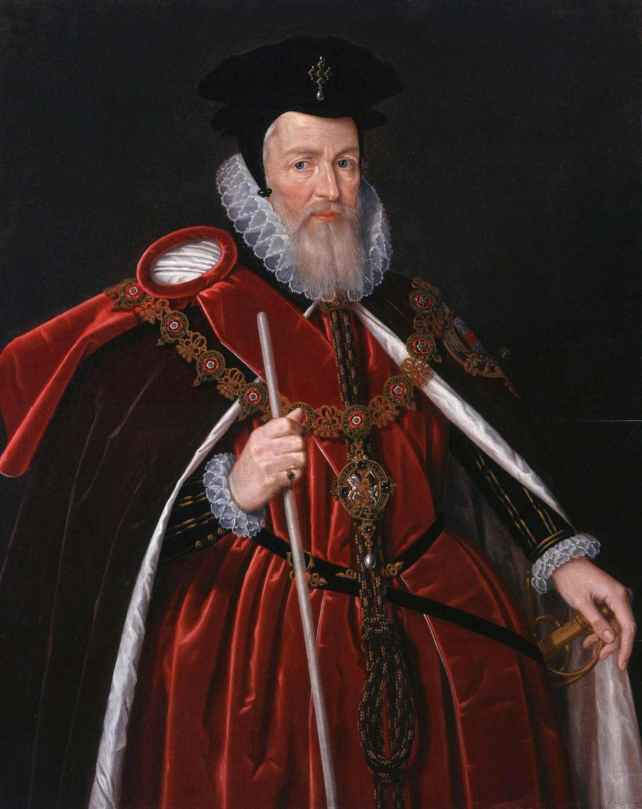

Wine Restrictions as a Tool of Mercantilism
Lord High Treasurer William Cecil, c.1598: “It is manifest that nothing robbeth the realm of England, but when more merchandise is brought into the realm, than is carried forth,” and the “remedy hereof is by all policies to abridge the use of such foreign commodities as be not necessary for us.” Most “hurtful to the realm” was wine imports that “enricheth France, whose power England ought not to increase.”
Alcohol in general and wine in particular will always be an attractive target (except with states that do not import or export it) because:
It is a sumptuary good.
It allows for easy targeting of specific countries, or regions (and political divisions) within a country.
There are always substitutes available (domestic or imported).
Notes:
Deep Dive: Public Procurement
Day Two Presentation

Slide 6
Point 2:
The 19th Century Practice of Unilateralism and the Bargaining Tariff
Notes:
Deep Dive: Public Procurement
Day Two Presentation

Slide 7
Trade Wars of the 19th Century
The only major European countries that did not play this game were the Netherlands (former hegemon) and the United Kingdom (current hegemon). Here the current U.S. role is a real departure.
Countries’ respect for the rule of law was secured only by their willingness first to negotiate treaties and then to abide by them. Remind us of anyone?
Even then, treaties were usually time-bound and could always be abrogated. The first-term NAFTA renegotiation has effectively been abrogated.
A very common practice was for states to raise their tariffs unilaterally and then offer to negotiate them down (the bargaining tariff). This is precisely where we are today. What we cannot know yet is how far the strategy might “succeed” in producing meaningful and sustainable agreements, and what the trading system will look like in the future.
Notes:
Deep Dive: Public Procurement
Day Two Presentation

Slide 8
Point 3:
Why Political Great Powers Can Sustain Longer Trade Wars than Commercial Great Powers
Notes:
Deep Dive: Public Procurement
Day Two Presentation

Slide 9
The Archetypes of Great Powers and Others Based on Market Power and Market Exposure
 |  | Market Exposure: Exports Relative to GDP
 |  | Low | High
Market Power: Share of Global Imports | High | Political Great Power: A state that controls large shares of imports but is less dependent on exports can, at little risk to itself, leverage the access to its market on which other, more exposed states are so dependent. Examples: Rome, Bourbon and Napoleonic France, the United States, and (increasingly) modern China. | Commercial Great Power: Great powers for whom trade is intrinsically important may be more prone than political great powers to prioritize commercial goals, and also have more at risk if they attempt to leverage their market power. Examples: Athens, Carthage, the Eastern Roman Empire, Victorian England, and Wilhelmine and modern Germany.
 | Low | Disengaged: States that are less dependent on exports are also less susceptible to commercial leverage; some states (even great powers) may deliberately disengage from trade so as to reduce their external vulnerability. Examples: Sparta, Tokugawa and Imperial Japan, Nazi Germany (partially), Maoist China, and the Soviet Union. Many states that are not great powers are disengaged. | Exposed: Export-dependent states place a high priority on trade, and are less able to resist demands for commercial or non-commercial concessions from great powers; they include most small countries, as well as some former commercial great powers. Modern states that are not great powers (and some that once were) are more often exposed than disengaged.
Notes:
Deep Dive: Public Procurement
Day Two Presentation

Slide 10
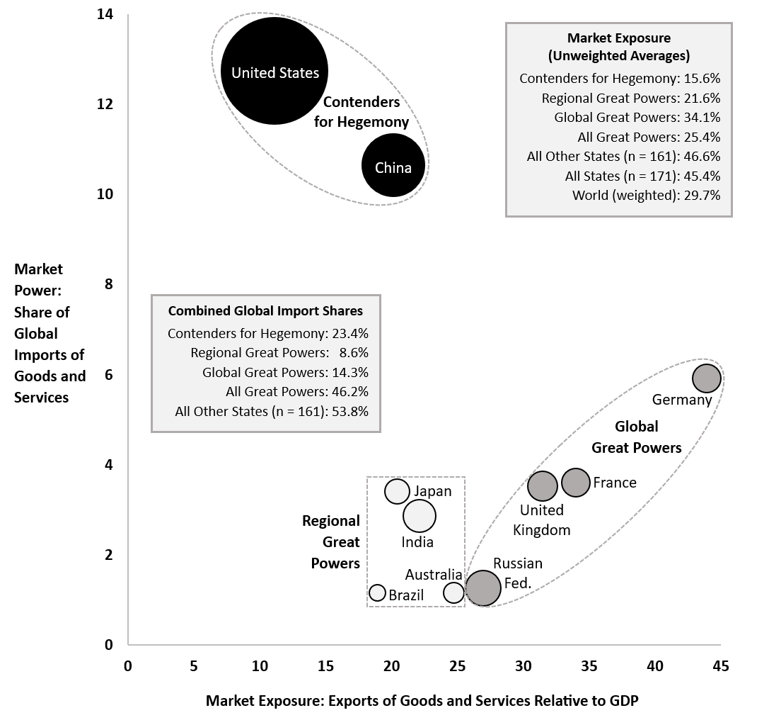
Today’s World Pits Two Political Great Powers Against One Another
Their low levels of market exposure ensure that both China and the United States can “take a punch” and keep up this fight as long as their domestic politics permit
The combined market power of China and the United States is as large as the combined economies of Africa and the Middle East
Germany is the only remaining commercial great power, and its E.U. membership is at least as much a constraint as a force-multiplier in its capacity to act
All other great powers (global and regional) have below-average levels of interest in trade
All these powers devote more political capital to negotiating discriminatory agreements, or prosecuting trade wars, than to revival of a moribund multilateral system
Notes:
Deep Dive: Public Procurement
Day Two Presentation

Slide 11
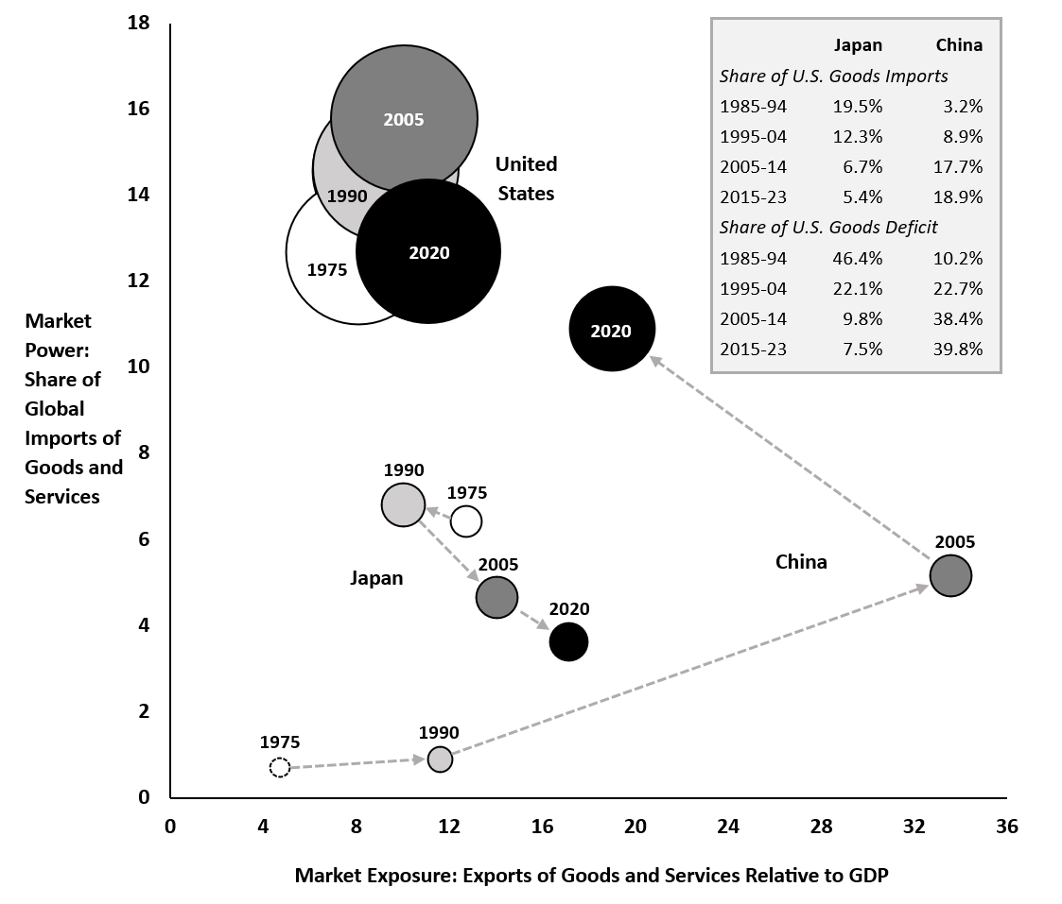
It Didn’t Have to Be this Way: Prior to a Pivotal Change in Strategy, China Was on the Way to Becoming a Commercial Great Power
During the Cultural Revolution (1966-1976) China was disengaged
From the 1990s until about 2005, China was on track to become a commercial great power, which (unlike the German challenge to Britain) the United States supported
Starting with the 11th Five Year Plan (2006-2010), China prioritized domestic over export-led growth
Even though China’s market power continued to increase, its market exposure decreased
China now rivals the United States not just in size but in type (political great power)
Both states are well-positioned to use trade policy as an instrument of foreign policy
All of this preceded Trump, but is vastly accelerated by him
Notes:
Deep Dive: Public Procurement
Day Two Presentation

Slide 12

Thank You
Notes:
Deep Dive: Public Procurement
Day Two Presentation

