Slide 1
AIDV U.S. Section Webinar Trump 2.0 - Challenges for the wine industry Panel 1: “The Big Picture”
Nicholas J. Bergman, Esq., Partner (Moderator)
Buchman Law Firm, LLP
Richard M. Blau, Esq., Partner, Regulated Products Section Chair
Gray Robinson, P.A.
Jacob Appelsmith, Esq., Principal
Law Offices of Jacob Appelsmith
April 22, 2025

Slide 2
Agenda
1. Introductions
2. Primer on the US system of Federalism
3. States’ rights
4. Current “state of affairs”
5. Canada and CA wine – lessons learned
6. Efficiencies in the time of upheaval – federal employee layoffs
7. Impact of the Administration’s policies on the states – immigration, environment, etc.
8. Labeling and industry regulation generally
9. Health warning, class actions and other cases of interests (Prop 65)
10. Tying it all together…

Slide 3
THE INTERNATIONAL WINE LAW ASSN. (AIDV)
US SECTION WEBINAR:
Alcohol Regulations – A New Regime?
Alcohol Regulations – A New Regime?
April 22, 2025
Zoom Webinar
Presentation of
Richard M. Blau, Chair
Regulated Products Section
© Richard M. Blau 2025 All rights reserved.

Slide 4
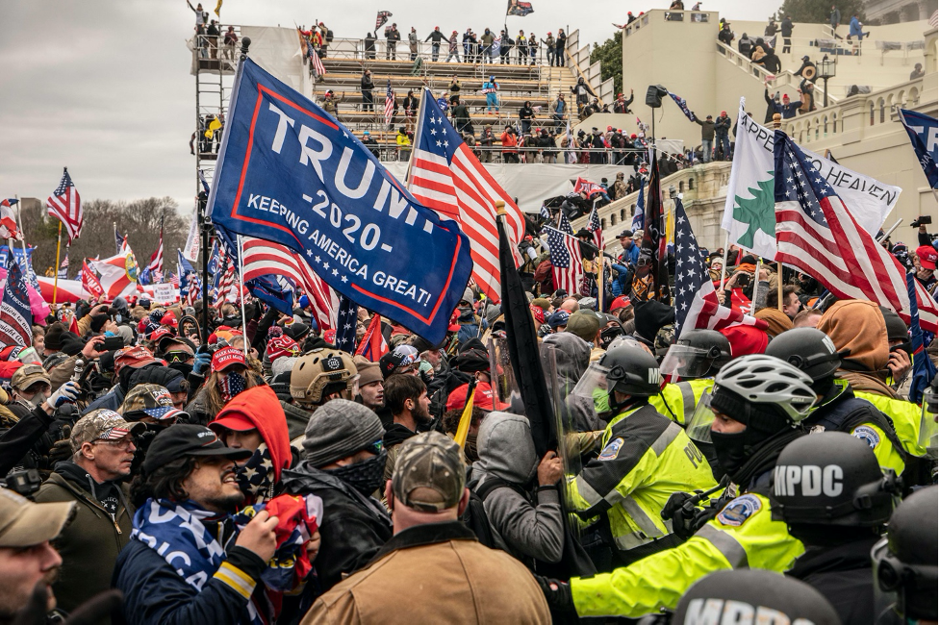
AMERICAN CHAOS: Understanding the present state of mind in U.S. Foreign Trade policy with respect to WINE

Slide 5
UNITED STATES EXPORTS
In 2024, the United States exported $1.24 Billion worth of wine.
The main destinations for U.S. wine exports were:
Canada (US$491 Million);
European Union (US$167.79 Million);
United Kingdom (US$163.81 Million);
China: (US$95.77 Million);
Japan (US$79.87 Million); and
South Korea (US$52.85 Million).
China and the United Kingdom were among the fastest-growing markets for U.S. wine exports between 2023 and 2024.

Slide 6
UNITED STATES IMPORTS
In 2024, the United States reportedly imported almost $6.789 Billion worth of wine.
The U.S. imported wine from 73 countries in 2024, but the bulk of the imports came from two dominant suppliers: France and Italy.
France (US$2.477 Billion);
Italy (US$2.402 Billion);
Spain (US$411,535);
Canada (US$208,652);
Portugal (US$117,513);
Chile (US$156,465);
Germany (US$86,590).

Slide 7
DEJA VUE?
The U.S. Canada Beer War of 1992
In 1992, Washington was threatening to impose duties on Canadian beer as retaliation for what it saw as a lack of fair access to the Canadian market for U.S. brewers.
New American duties, with tariffs of up to $4 per case of Canadian beer, could have wiped out the profits on $200-million worth of Canadian beer that was being exported each year to the U.S.
ULTIMATELY, the U.S. elected not to proceed with the tariffs after an agreement was reached for Canada to open up its domestic market on terms equal to those of the U.S.
THE CORE QUESTION FOR NEGOTIATORS: With the U.S. being such a prime market, is there more to gain by being in the United States than not?

Slide 8
TRANSACTIONAL AMERICA
At some level, all nations are transactional.
What defines the current U.S. president is his unabashed determination to achieve desired objectives, often at the expense of values, alliances, and even treaties.
Nations that have come to rely on U.S.-backed alliances will certainly need to recalibrate.
Global markets will experience turbulence.
But countries and companies will also exploit the changed arena to secure previously unattainable opportunities.
The ones with the means to do so will look to exploit the U.S. president’s tendency to prioritize his self-interest as the personification of America’s best interests.

Slide 9
A BRIEF PRIMER ON AMERICA’S “FEDERALISM” AND THE SHIFTING SANDS OF CONGRESSIONAL DELEGATION TO EXECUTIVE AGENCIES

Slide 10
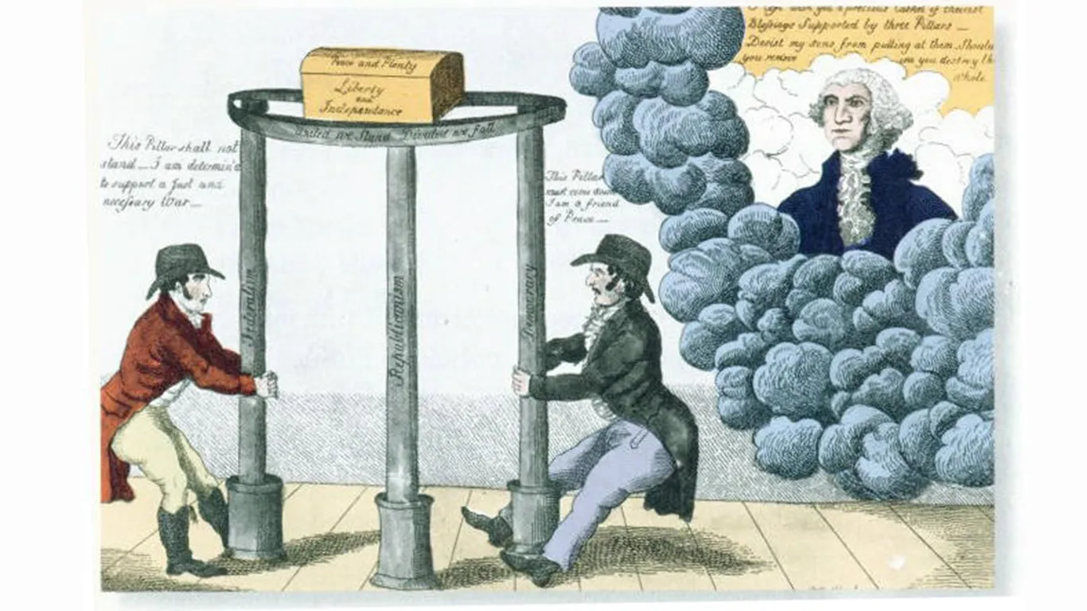
WHAT IS FEDERALISM?

Slide 11
What is “Federalism?”
The legal doctrine of federalism defines the division of power between the federal government and the states, aiming to balance national unity with state autonomy.
The US Constitution grants specific powers to the federal government, while reserving all other powers to the states or the people.
Examples of Federalism:
The federal government has the power to declare war, while states have the power to establish local police forces.
The Constitution grants Congress the authority to regulate foreign commerce, impose tariffs, and collect revenue, while the President holds constitutional authority to negotiate with foreign governments. States have no constitutional role in foreign trade negotiations.

Slide 12
NON-DELEGATION PRINCIPLES AND THE BALANCE OF CONGRESSIONAL AND EXECUTIVE AUTHORITY
Courts have infrequently opined on the ways in which the United States may enter into foreign trade agreements based on the separation of powers between the Legislative and Executive branches of federal government.
It is generally accepted that the United States may enter into trade agreements with other countries via "congressional-executive agreements," which are negotiated by the President and approved—either in advance or afterward—by Congress.
TODAY, however, questions are arising about whether the President may enter into trade agreements with other countries via "sole executive agreements," which are not approved by Congress and rest on the President's independent constitutional powers.
The current administration in the U.S. is making what appear to be various nonbinding trade commitments to other countries without congressional authorization, based on the President’s asserted authority to conduct foreign policy.

Slide 13
NON-DELEGATION PRINCIPLES AND THE BALANCE OF CONGRESSIONAL AND EXECUTIVE AUTHORITY
Recent years have seen a shift in how the United States enters into trade agreements.
Trade Promotion Authority (TPA) statutes usually empower the President to negotiate agreements and adjust tariff rates. Since the 1970s, they have also included expedited congressional procedures to consider legislation necessary to implement agreements that involve both tariff and nontariff barriers, provided the President meets certain negotiating objectives as well as notification/consultation requirements.
Most recently, Congress used TPA-2015 to approve and implement the U.S.-Mexico-Canada Agreement (USMCA), which entered into force in 2020 and replaced the North American Free Trade Agreement (NAFTA).

Slide 14
NON-DELEGATION PRINCIPLES AND THE BALANCE OF CONGRESSIONAL AND EXECUTIVE AUTHORITY
HOWEVER, the last TPA authorization by Congress expired in 2021, leaving this vehicle for congressional-executive agreements unavailable for the present.
In recent years, American Presidents have entered into various bi-lateral and multi-lateral trade agreements (sometimes called "mini-deals") that are not specifically approved by Congress.
But what about areas that are specifically the responsibility of Congress, such as TARIFFS?
The current Administration claims its recent trade actions are "hybrid" trade agreements because they are difficult to classify according to the traditional categories of congressional-executive and sole executive agreements.
Unlike congressional-executive agreements, they are entered into without specific ex ante or ex post congressional approval.
On the other hand, unlike sole executive agreements, they are not necessarily based on the President's independent constitutional powers, but purport to rest at least partly on powers Congress has delegated by statute to the executive branch.

Slide 15
NON-DELEGATION PRINCIPLES AND THE BALANCE OF CONGRESSIONAL AND EXECUTIVE AUTHORITY
Some Members of Congress have questioned whether mini-deal trade agreements are constitutionally permissible and have sought to reassert Congress's role in the making of foreign trade agreements.
Another criticism from some commentators is that the executive branch often does not identify the source of its authority to enter into these agreements, with some agreements apparently lacking or exceeding authority that Congress has delegated to the executive branch.
IN CONTRAST, one argument that proponents have advanced to support the constitutionality of hybrid trade agreement is that Congress gave or delegated to the U.S. Trade Representative the authority to enter into trade agreements by enacting USTR's organic statute, 19 United States Code Section 2171, and that for at least the last 30 years, USTR has negotiated and entered into numerous agreements pursuant solely to this authority.
But can Congress delegate tariff authority when the Constitution says that power belongs to the Legislative branch?

Slide 16
What are “Non-Delegation Principles?”
To understand non-delegation principles, start with the concept of “delegation” as it relates to authority granted by the legislature to an administrative agency.
For example, under the U.S. Constitution although Congress cannot irrevocably “transfer” or “alienate” legislative power, it can revocably “delegate” it to a federal administrative agency.
Over time, federal courts not only acknowledged that ability of Congress to delegate authority to the agencies of the Executive branch, they expanded their view of delegation to encompass “deference” to the agency when a specialized knowledge was involved.
In 1983, the U.S. Supreme Court galvanized this concept of deference as a component Congressional delegation in the 1983 case of Chevron USA v. National Resources Defense Council.

Slide 17
WHAT ARE NON-DELEGATION PRINCIPLES ?

Slide 18
NON-DELEGATION PRINCIPLES AND THE REBALANCING OF THE CONGRESSIONAL AND EXECUTIVE POWER
In 2024, the U.S. Supreme Court decided the case of Loper Bright Enterprises v. Raimondo.
In a 6-2 decision authored by Chief Justice Roberts, the Loper court concluded that courts must exercise their independent judgment in deciding whether an executive branch agency has acted within its statutory authority, and courts may not defer to an agency interpretation of the law simply because a statute is ambiguous.
Chevron was overruled because Congress cannot alienate its constitutional responsibilities, and unless a statue creating an executive agency clearly defines the limits of that agency’s authority, the courts must "decide all relevant questions of law" when reviewing agency actions. This means courts should use their own judgment to interpret laws, not defer to agencies' interpretations.
Chevron was based on a “flawed assumption” that Congress intends to delegate interpretive authority to agencies whenever a law is ambiguous.
According to the Loper majority, this assumption does not reflect reality and goes against the traditional role of courts.

Slide 19
NON-DELEGATION PRINCIPLES AND THE REBALANCING OF FEDERALISM & STATES’ RIGHTS
WORTH NOTING: In a concurring opinion, Justice Clarence Thomas wrote that:
“I write separately to underscore a more fundamental problem: Chevron deference also violates our Constitution’s separation of powers, as I have previously explained at length. . . Chevron compels judges to abdicate their Article III “judicial Power.” §1. “[T]he judicial power, as originally understood, requires a court to exercise its independent judgment in interpreting and expounding upon the laws.” . . By tying a judge’s hands, Chevron prevents the Judiciary from serving as a constitutional check on the Executive. It allows “the Executive . . . to dictate the outcome of cases through erroneous interpretations.” . . .
Chevron deference also permits the Executive Branch to exercise powers not given to it. “When the Government is called upon to perform a function that requires an exercise of legislative, executive, or judicial power, only the vested recipient of that power can perform it.” . . .
“The Constitution carefully imposes structural constraints on all three branches, and the exercise of power free of those accompanying restraints subverts the design of the Constitution’s ratifiers.”
Citations omitted; Emphasis added.

Slide 20
THE THOMAS CONCURRENCE IN LOPER (2024)
In a concurring opinion to the Loper case, Justice Clarence Thomas wrote that:
“I write separately to underscore a more fundamental problem: Chevron deference also violates our Constitution’s separation of powers, as I have previously explained at length. . . . [W]e should not overlook Chevron’s constitutional defects in overruling it. To provide ‘practical and real protections for individual liberty,’ the Framers drafted a Constitution that divides the legislative, executive, and judicial powers between three branches of Government. Chevron deference compromises this separation of powers in two ways. It curbs the judicial power afforded to courts, and simultaneously expands agencies’ executive power beyond constitutional limits. . . .
“Chevron compels judges to abdicate their Article III “judicial Power.” §1. ‘[T]he judicial power, as originally understood, requires a court to exercise its independent judgment in interpreting and expounding upon the laws.’ . . By tying a judge’s hands, Chevron prevents the Judiciary from serving as a constitutional check on the Executive. It allows ‘the Executive . . . to dictate the outcome of cases through erroneous interpretations.’ . . .
“Chevron deference also permits the Executive Branch to exercise powers not given to it. ‘When the Government is called upon to perform a function that requires an exercise of legislative, executive, or judicial power, only the vested recipient of that power can perform it.’ . . .
“The Constitution carefully imposes structural constraints on all three branches, and the exercise of power free of those accompanying restraints subverts the design of the Constitution’s ratifiers.”
(Citations omitted; Emphasis added).

Slide 21
WHERE DOES TRADE POLICY STAND TODAY IN THE CONTEXT OF THE CONSTITUTION AND THE NON-DELEGATION DOCTRINE?
Today’s U.S. Supreme Court is demonstrably more “conservative” in its jurisprudence, but also more radical in its willingness to minimize or even ignore the longstanding doctrine of stare decisis where that is perceived as an impediment to doctrinal realignment with originalist and textualist principles.
As the current administration faces numerous judicial challenges to its extraordinary exercise of executive authority, the Supreme Court’s new conservative majority could yield a profoundly different conclusion from trade precedents of the last 30+ years.

Slide 22
THANK YOU
Richard M. Blau
richard.blau@gray-robinson.com
(866) 382-5132
© Richard M. Blau 2025 All rights reserved.

